Slide 1
‘COPS ON STREAM,
SUBMITTED BY:
Abdulla M
Shanish Pearl
Mijwad V
Suhail PT

Slide 2
ABSTRACT
Online platform enabling citizens to report crimes to law enforcement.
Crime reporting forms and notifications integrated into the system.
Convenience for citizens to report crimes anytime, anywhere.
Eliminates the need for physical visits to police stations.
Saves time and effort for both citizens and law enforcement.
Includes crime statistics and incident mapping features.
Provides a visual representation of crime locations.
Helps law enforcement allocate resources strategically based on incident mapping.
Enables law enforcement to make informed decisions using crime statistics.
Empowers citizens to actively contribute to community safety through reporting.

Slide 3
EXISTING SYSTEM
Current system faces challenges affecting efficiency.
Visiting police stations can be intimidating and time-consuming.
Deters prompt incident reporting.
Operational hours limitation restricts accessibility.
Difficulty seeking assistance during non-operational hours.
Burdensome travel to police stations.
Lack of feedback hinders evaluation and refinement.
Recognizes the need for overall improvements.
Address intimidation and time constraints.
Improve accessibility with extended hours.
Consider online reporting systems.
Introduce feedback loops for continuous improvement.
Minimize time constraints for timely reporting.
Addressing challenges enhances overall efficiency.

Slide 4
PROPOSED SYSTEM
Addresses limitations in current crime reporting methods.
Uses technology for accessibility, user-friendliness, and efficiency.
24/7 reporting available from any device.
Cross-platform accessibility with responsive design.
Provides immediate case confirmation.
Optional notifications keep citizens updated on case status.
Continuous improvement based on user feedback.
Streamlines case assignment and status tracking for law enforcement.
Notifications enhance transparency and communication.
Secure dashboard facilitates efficient case handling.
Responsive design ensures seamless reporting across devices.
Emphasizes secure handling of citizen and law enforcement data.
CopsOnStream introduces a tech-driven solution, making crime reporting easy for citizens and providing law enforcement with an efficient platform for incident management and analysis.

Slide 5
SOFTWARE USED:
PROGRAMMING LANGUAGE : Python
FRONTEND DEVELOPMENT : HTML , CSS , JAVASCRIPT
BACKEND FRAMEWORK : Python Django
DATABASE : MySQL
HARDWARE USED:
OPERATING SYSTEM : Windows
PROCESSOR : INTEL core i3
RAM : 4GB OR HIGHER
STORAGE : 256GB
INTERNET CONNECTION : Stable and high speed internet connection

Slide 6
MODULES
ADMIN:
Login
View or update profile
Accept or reject complaints
View complaints
Assign to police officer
View user details
View case details
logout
POLICE:
Login
View reported crime
Update crime report
Review complaint

Slide 7
USER:
Register
Report crime
View update
Case details
Rating & Feedback

Slide 8
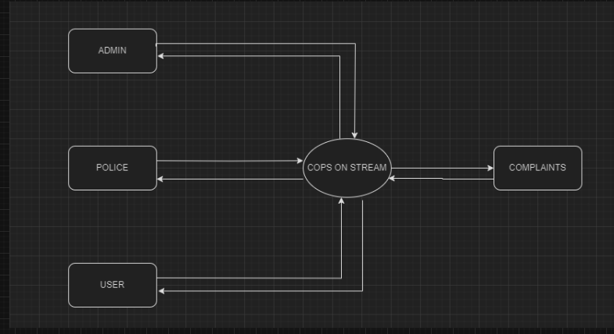
DFD
ZEROTH DFD

Slide 9
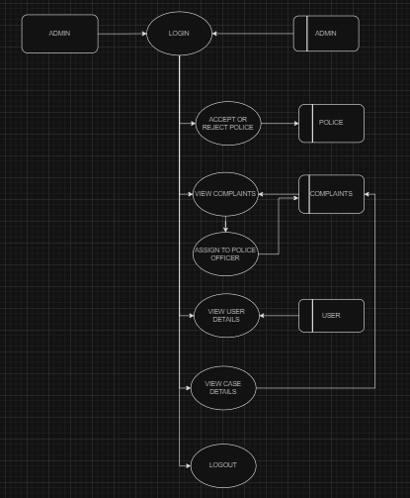
ADMIN

Slide 10
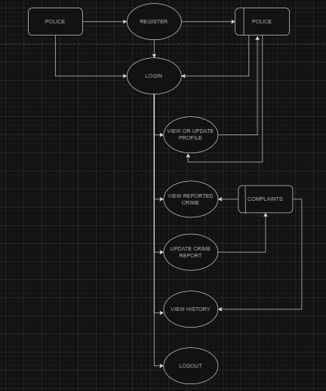
POLICE

Slide 11
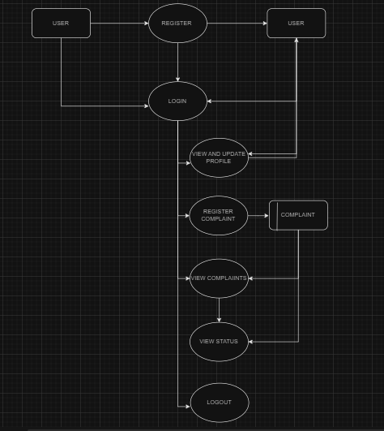
USER

Slide 12
TABLES
ADMIN
FIELD | DATATYPE | SIZE | CONSTRAINTS | DESCRIPTION
admin_id | int | 20 | Primary key | Admin id
admin_name | varchar | 40 |  | Admin name
email_id | int | 15 |  | Email id
Password | varchar | 15 |  | password

Slide 13
POLICE
FIELD | DATATYPE | SIZE | CONSTRAINTS | DESCRIPTION
Police_id | int | 20 | Primary key | police id
police_name | varchar | 40 |  | police name
Phone_number | int |  |  | Number of police officer
Profile_picture | img |  |  | Picture of police officer
rank | varchar |  |  | Police rank
email_id | int | 15 |  | Email id
password | varchar | 15 |  | password
Location | varchar | 20 |  | Location of police station

Slide 14
USER
FIELD | DATATYPE | SIZE | CONSTRAINTS | DESCRIPTION
user_id | int | 20 | Primary key | User id
user_name | varchar | 40 |  | User name
age | int | 20 |  | User age
gender | varchar | 20 |  | User gender
Phone number | int | 20 |  | Number of user
email_id | int | 15 |  | Email id
password | varchar | 15 |  | password

Slide 15
CASE DETAILS
FIELD | DATATYPE | SIZE | CONSTRAINTS | DESCRIPTION
case_id | int | 20 | Primary key | case id
case_details | varchar | 40 |  | Case details
case_status | varchar | 30 |  | Case status
location | varchar | 20 |  | Case location
police_id | int | 15 | Foreign key | Police id
user_id | int | 15 | Foreign key | User id

Slide 16
REVIEW
FIELD | DATATYPE | SIZE | CONSTRAINTS | DESCRIPTION
review_id | int | 20 | Primary key | review id
case_id | int | 20 | Foreign key | Case id
user_id | int | 20 | Foreign key | user_id
reviews | varchar | 50 |  | Review of case

